Slide 1
ORBIT in Phoenix
Capabilities • Roadmap alignment (internal)
Align on the ORBIT roadmap
and how we’ll deliver it in 2026
Purpose: align on the dedicated roadmap (what, why, priority).
Audience: HRT; demo will show how ORBIT operates in Phoenix.
Output: prioritized backlog + owners + next decisions.

Slide 2
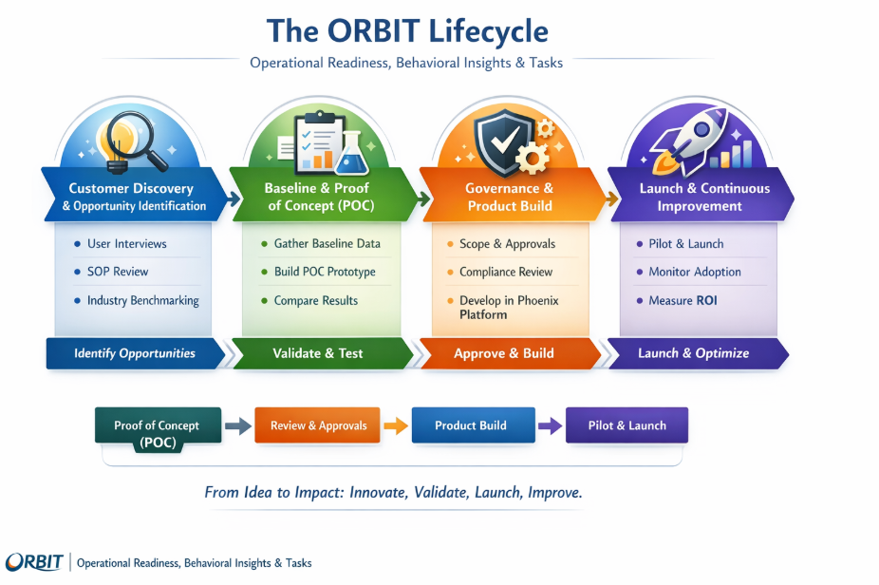
How ORBIT is delivered in Phoenix
Chatbot • Slack access • Scheduled emails
Notes:
Phoenix Chatbot (primary UI): run ORBIT and view the Daily People Pulse + focus areas.
Slack access: share narratives and key lists quickly with leaders and HR partners.
Scheduled emails: daily/weekly digests (People Pulse + summaries) to targeted audiences.
Consistent templates: email-ready narratives and “Recommendations to consider” with SOP links.
Governance-by-design: human-in-the-loop; systems of record stay authoritative.

Slide 3
ORBIT Demo
Top 3 main ways to interact with ORBIT
Phoenix ORBIT Agent (primary UI)
Slack
Scheduled emails: daily/weekly digests

Slide 4
Prioritized roadmap snapshot
High-level view (what we build next)
#
Product / Area
Primary users
Primary focus / signals
Delivery
1
Daily People Pulse (DPP)
Local HR, Ops Leads
Daily attendance, recognition, staffing
Workflow + some AI
2
TMDM Paycode Reconciler
HR, Payroll
Paycode mismatches & pay risk
Workflow
3
ORBIT Workload Lens
HR Leadership, Local HR
Where HR time goes; ORBIT impact
Workflow + some AI
4
CAT Insights
CAT, HR, Ops
Patterns, hotspots, alerts
Workflow + some AI
5
VOC Insights
HR, Ops, CX
Themes from VOC → action
AI + Workflow
6
Timesheet Approvals
HR, Managers
At-risk approvals before deadlines
Workflow
7
LOA Pulse
HR
RTW completion & gaps
Workflow
8
Bubble Report Generator
HR, Ops
Department health & risk
Workflow
9
ECHO Pulse
HR, Site Leadership
ECHO outcomes → actions
AI + Workflow
10
General Announcements
HR, Ops
Targeted announcements
Workflow + some AI
11
Smart VET/VTO Automation
HR, Ops
VET/VTO guidance + SLA impact
Workflow + some AI
12
FMLA Hours Audit
HR
FMLA compliance audit
Workflow
13
BRT Scheduling
HR, Ops
Scheduling recommendations
Workflow
14
1:1 Completion & Quality
HR, Ops Leaders
Cadence + quality proxies
Workflow
15
On Premise
HR, IT
Constrained environments capability
Workflow

Slide 5
Roadmap backlog (for alignment)
Capture comments + confirm priority
What it is
Short description
Meeting comments / takeaways
Priority
Daily People Pulse (DPP)
Daily narrative + radars; email-ready outputs
P0
Bubble Report Generator
Dept risk/health view; focus HR/Ops time
P0
ORBIT Workload Lens
Where Local HR time goes + ORBIT impact
P0
TMDM Paycode Reconciler
Exception list for paycode mismatches / pay risk
P1
Timesheet Approvals
At-risk approvals + nudges before deadline
P1
LOA Pulse
RTW checklist + gap surfacing
P1
CAT Insights
CAT patterns/hotspots integrated into ORBIT
P2
VOC Insights
Theme extraction → actions; reduce false alerts
P2
ECHO Pulse
ECHO outcomes → site narratives + actions
P2
General Announcements
Targeted HR/Ops announcements
P3
Smart VET/VTO Automation
Proactive staffing guidance + analytics
P3
FMLA Hours Audit
Compliance audit views + exceptions
P3

Slide 6
Decisions + next steps
What we need from this meeting
Confirm the prioritized backlog (P0/P1/P2) for 2026 delivery.
Align on the API path + engineering ownership to meet data freshness standards.
Confirm validation criteria (DPP + Bubble) and the Rx → FC rollout sequence.
Agree on standard work integration approach (SOP mapping + deep links).
Partner with HR Analytics to validate ROI assumptions and publish recurring readouts.
Demo plan (today)
Show Phoenix ORBIT Agent
Run Daily People Pulse
Preview Slack + scheduled email outputs
Review roadmap table & capture comments

